Slide 1
BTT Recorder v1.4
Editing
Recordings
Verse markers
And
rating

Slide 2
Verse Markers
Verse markers are only available for when recordings are done in chunk mode.

Slide 3
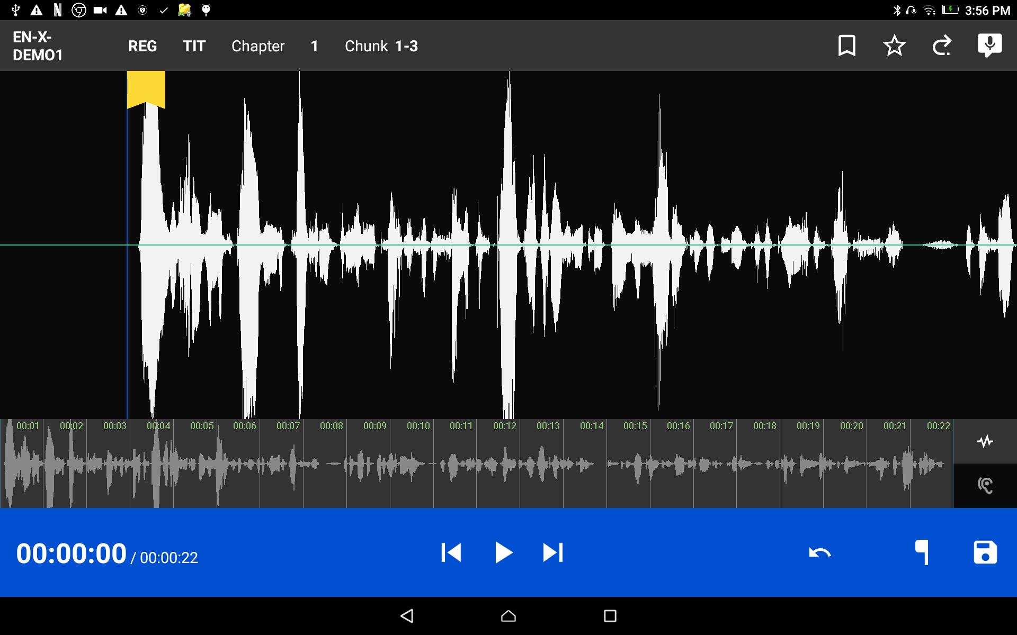

Verse Markers
Open the recording that has been edited and is ready to share with others.
Tap on the bookmark icon.

Slide 4
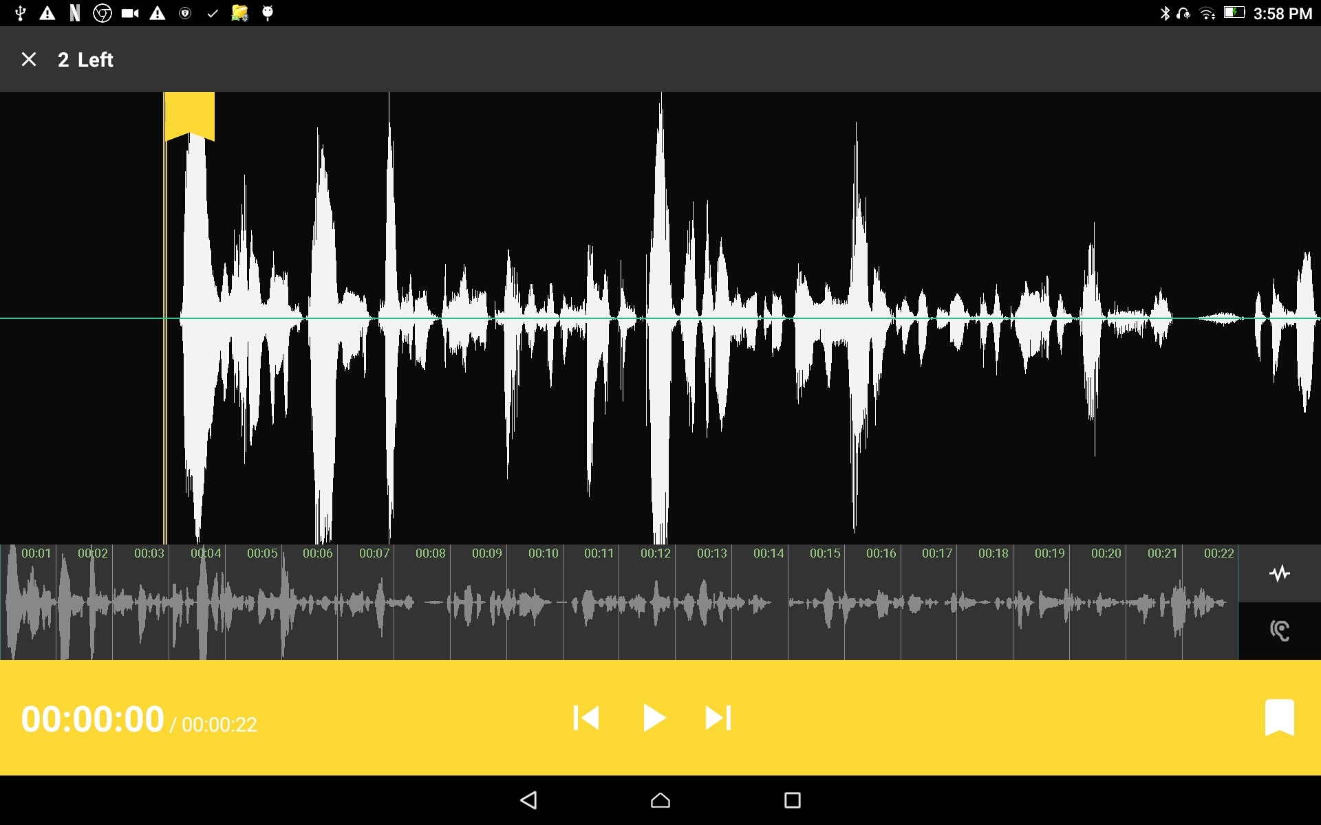
Verse Markers
The top gray bar has the number of markers left to put into place.
A verse marker is at the beginning of the recording.
Notice that the playback bar is yellow.

Slide 5
Verse Markers
Tap the play icon to playback the recording.

Slide 6
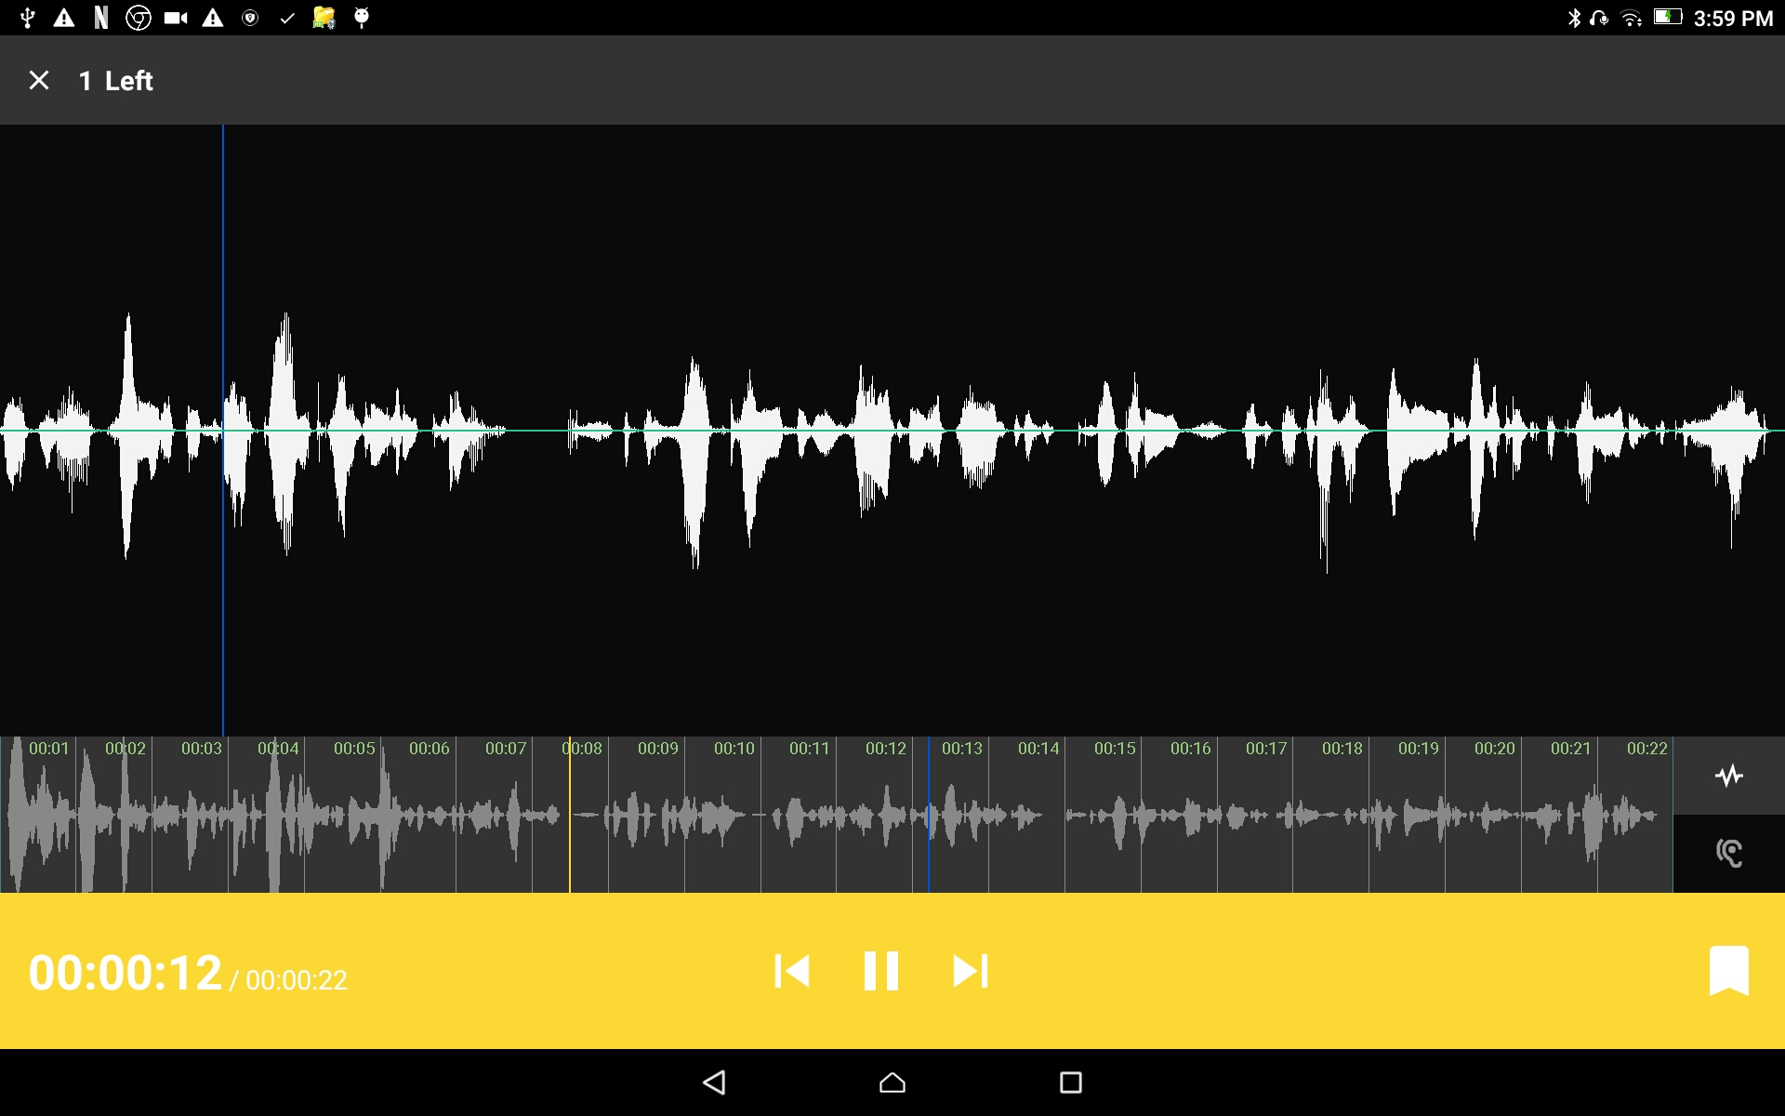
Verse Markers
Tap the pause icon to stop the playback when it is at a verse ending.

Slide 7
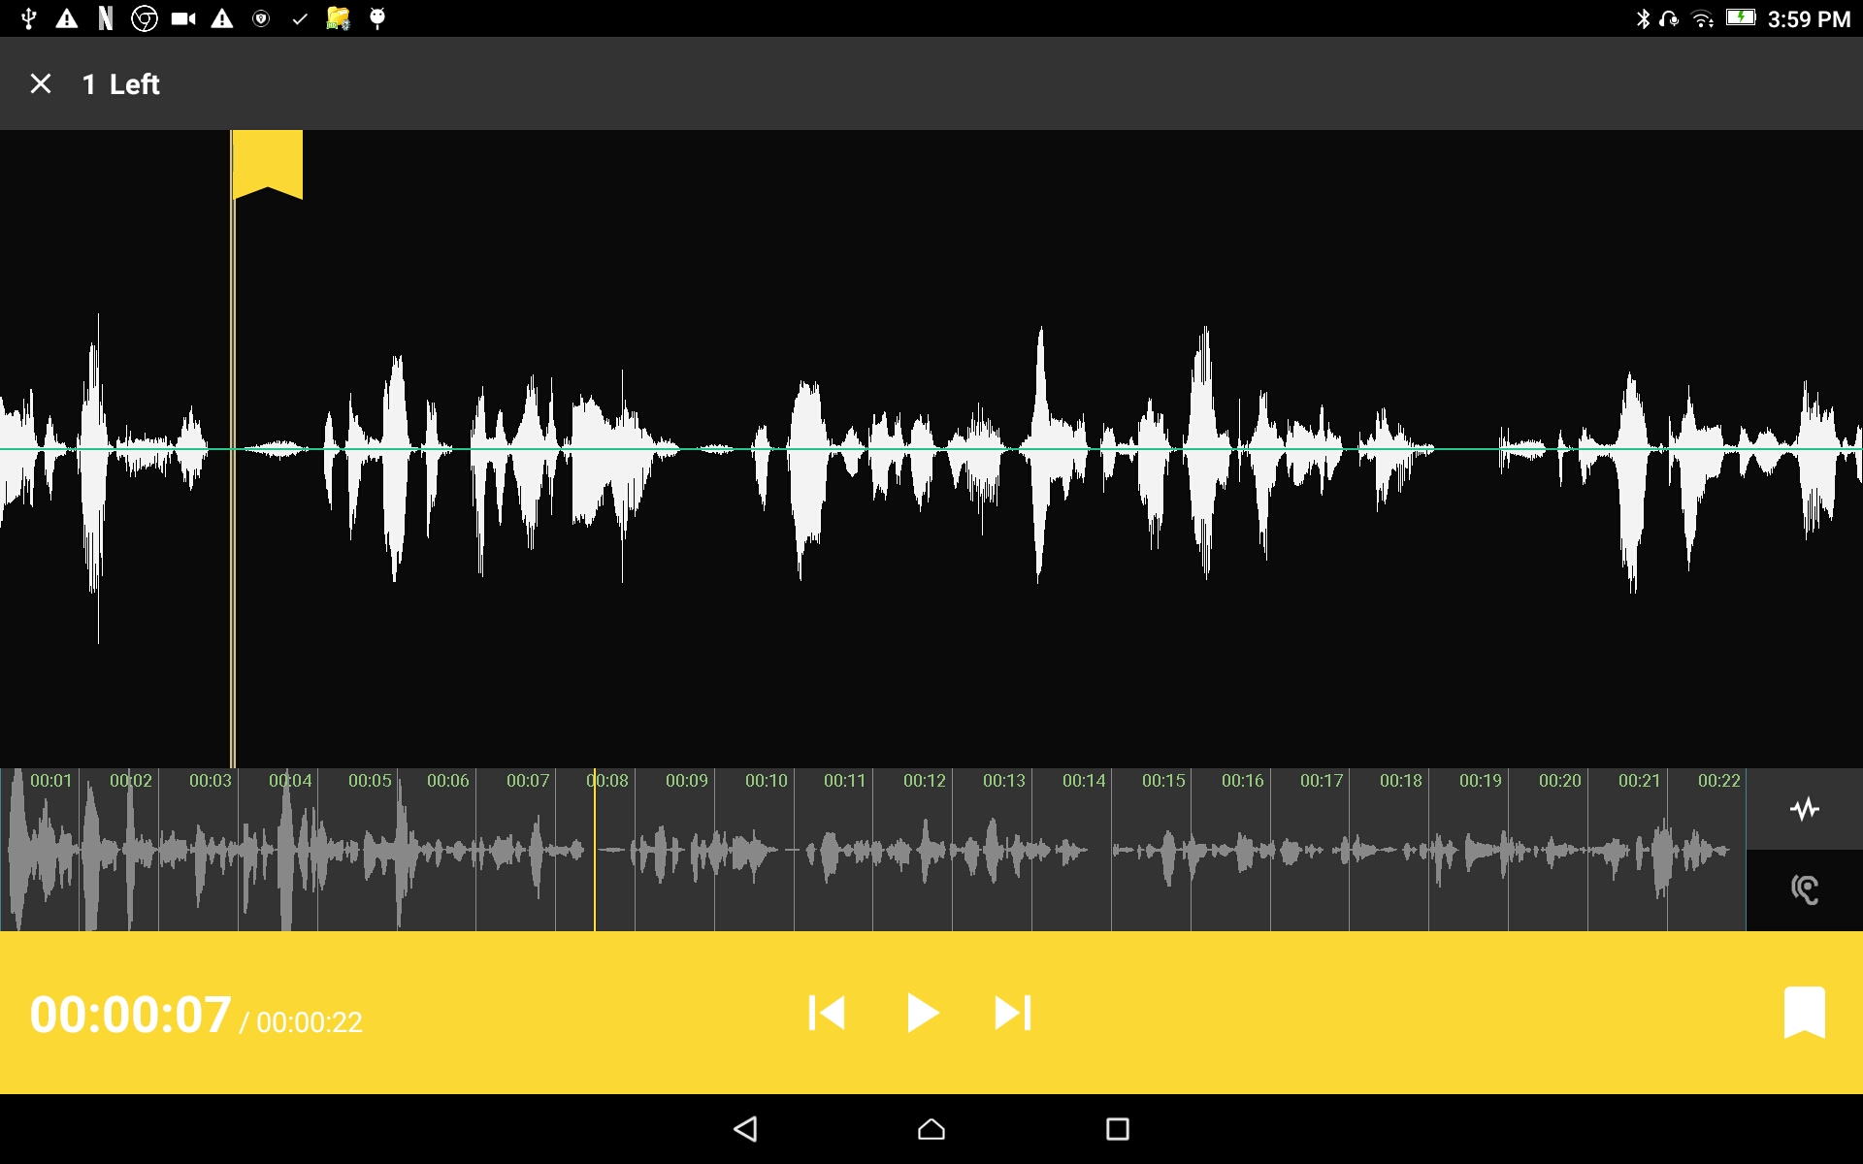
Verse Markers
To add the verse marker:
Tap the white flag on the yellow bar.
Continue to listen to the playback for the next ending of a verse.

Slide 8
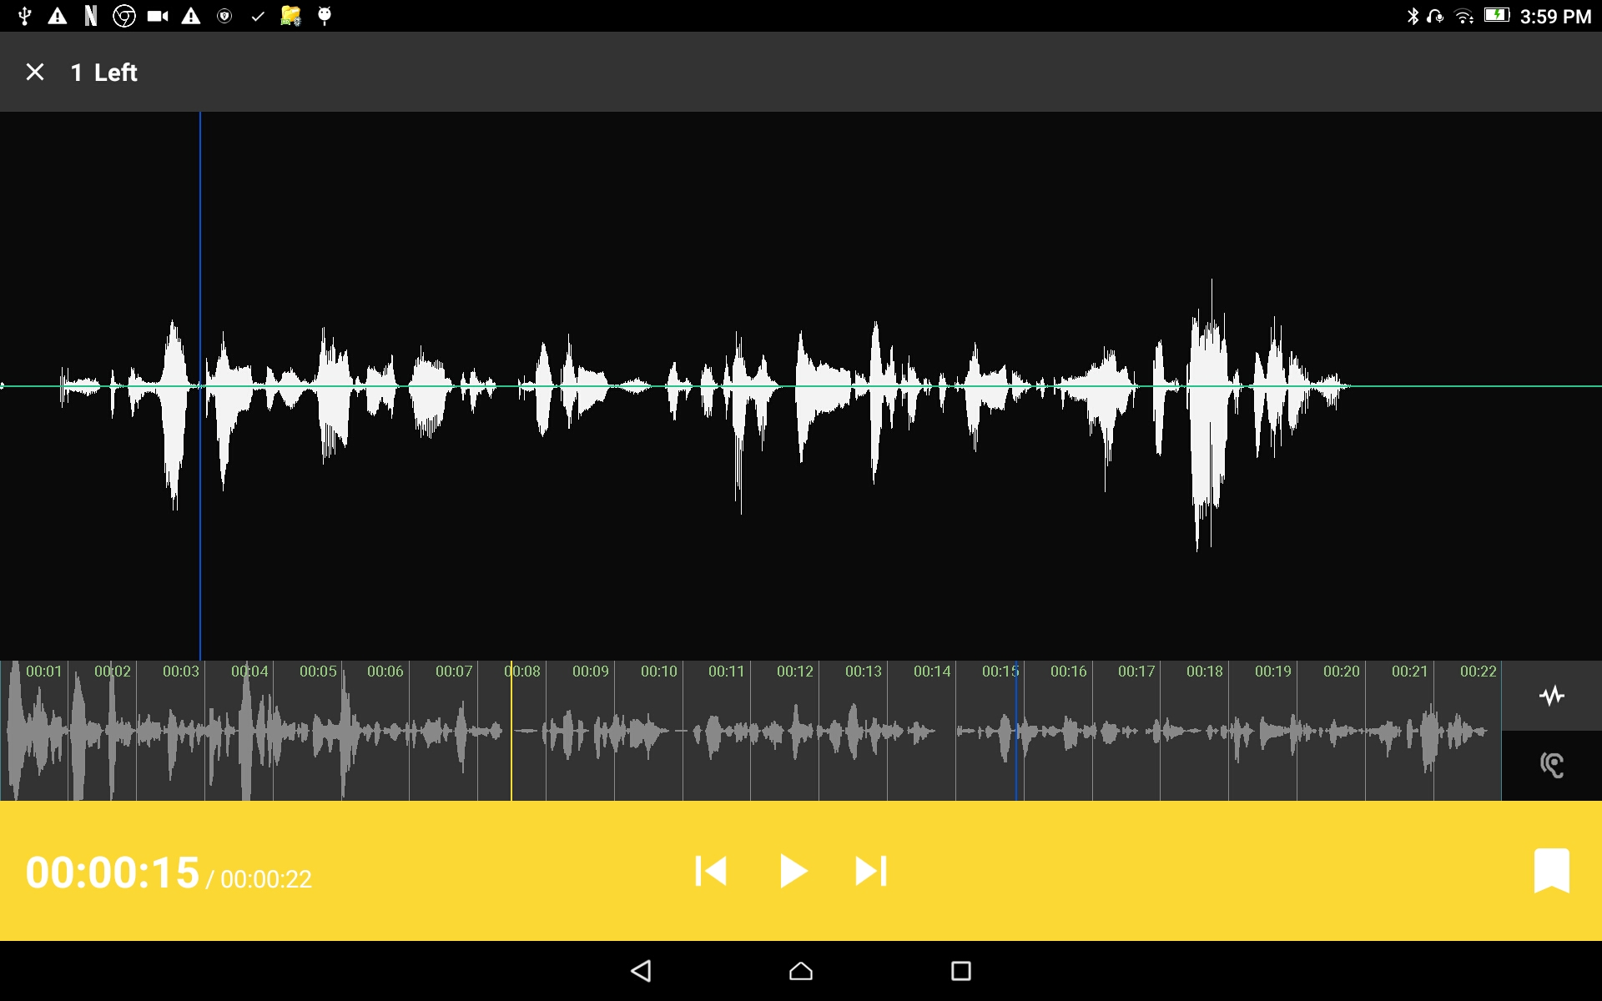
Verse Markers
Optional way of finding the correct spot in the recording:
Use the press-hold-drag action to move the playback forward or backward.
Have the verse division on the blue line.

Slide 9
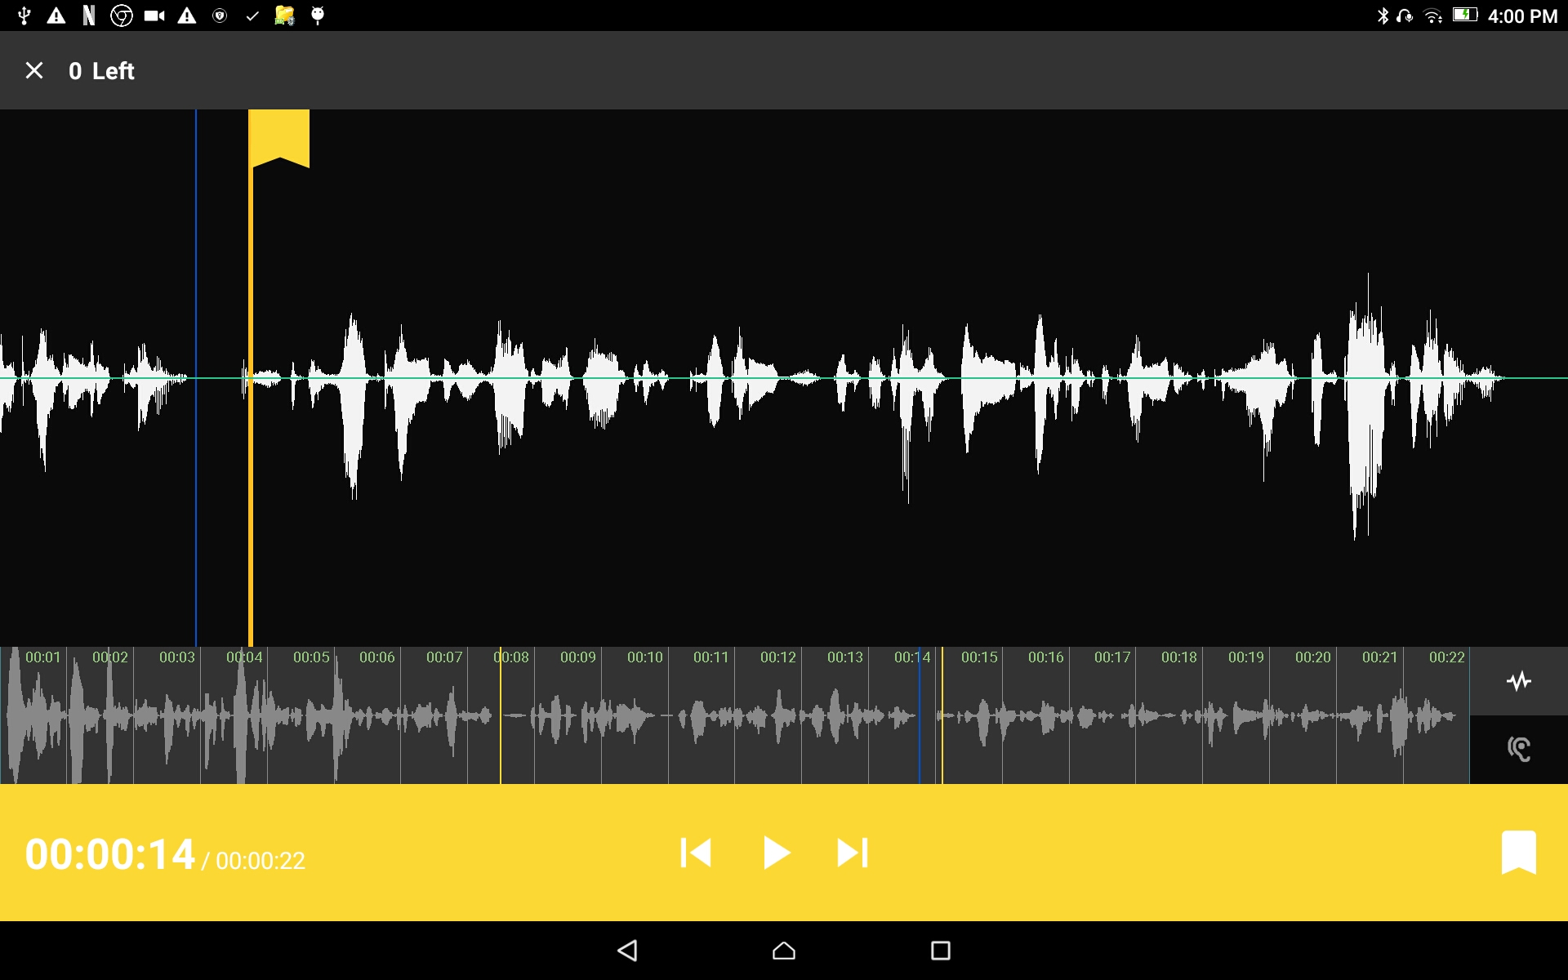
Verse Markers
Another way of finding the correct spot in the recording:
Use the press-hold-drag action to move the flag forward or backward on the wave form.

Slide 10
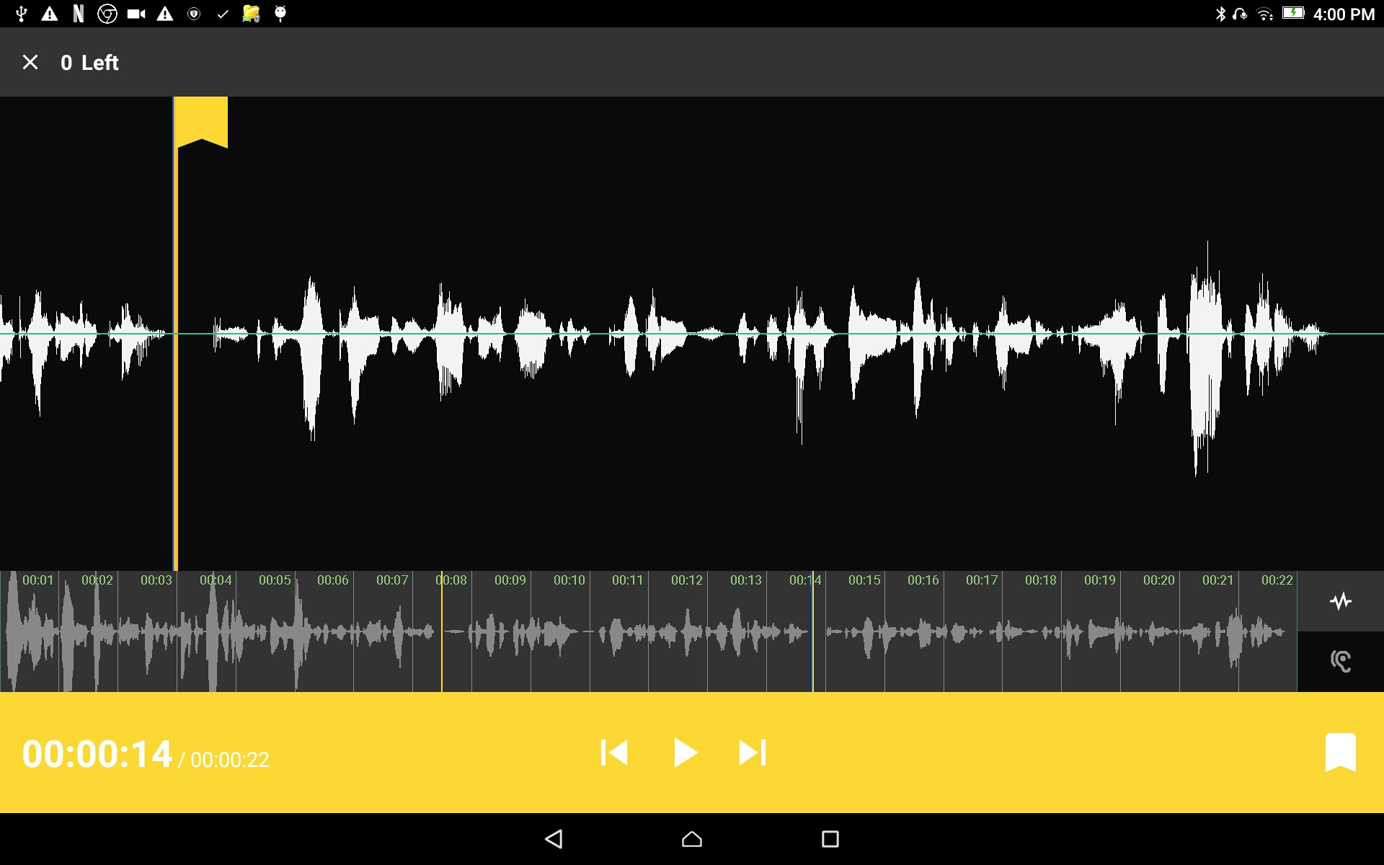
Verse Markers
When there are no more verse markers to place –
Tap the back icon found under the yellow bar.

Slide 11
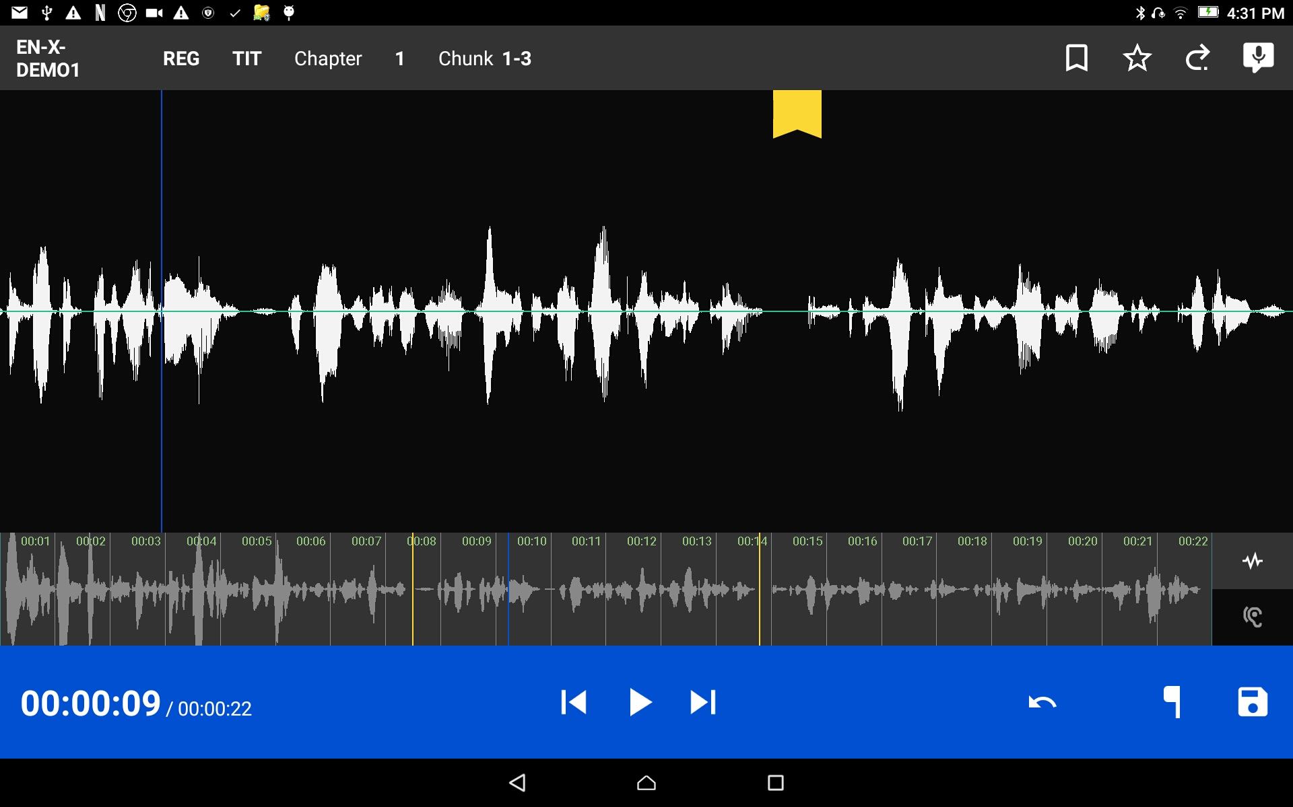
Verse Markers
The verse markers are shown on the recording screen.
Tap the SD Card icon to save and return to Project Management.
HINT: you might want to rate this recording before saving.

Slide 12
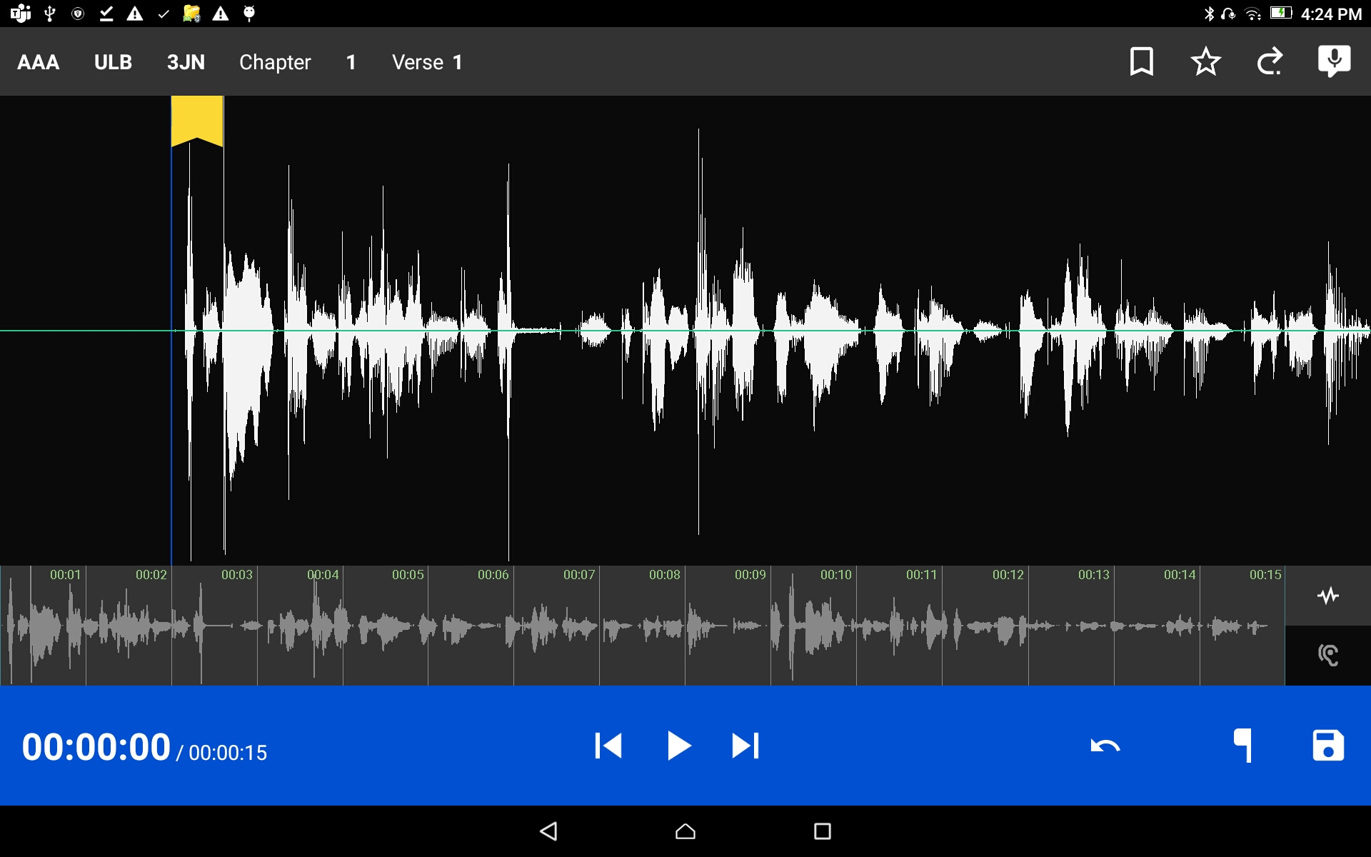

Rating a Recording
Tap the star icon on the top gray bar.

Slide 13
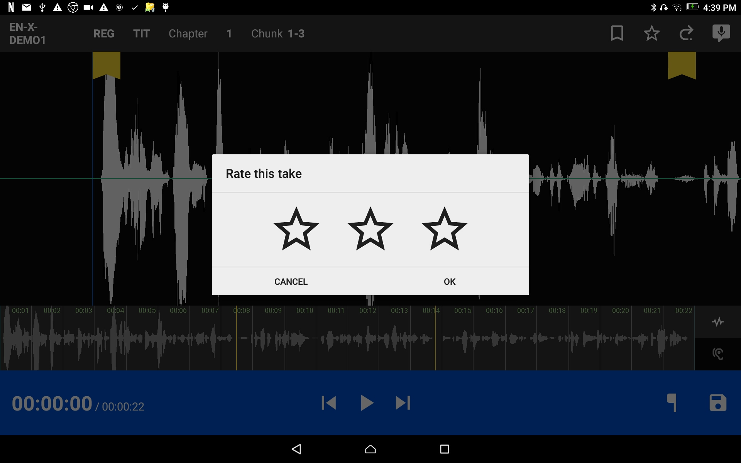
Rating a Recording
Tap the stars for rating.
The star on the left for a 1-star rating – meaning this is a good recording.
The star turns red.
The middle star for a 2-star rating – meaning this is a better recording.
The stars turn yellow.
The star on the right for a 3-star rating – meaning this is an excellent recording.
The stars turn green.

Slide 14
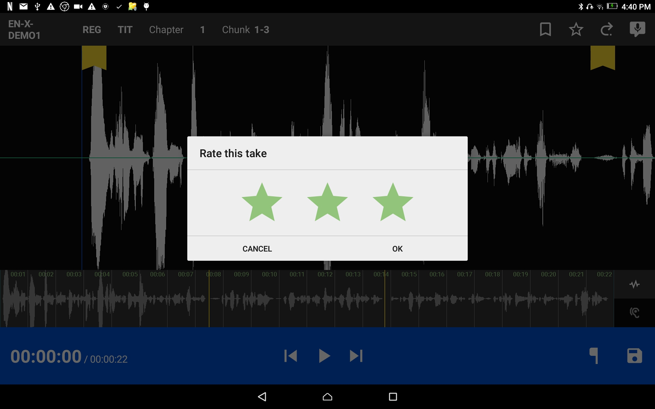
Rating a Recording
Tap on ‘OK’ to save the rating.

Slide 15
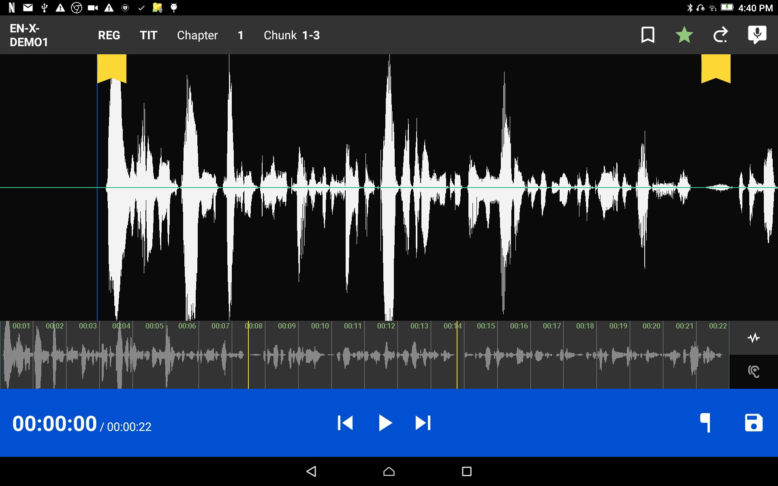
Rating a Recording
The star on the gray bar is the color of the rating.

Slide 16
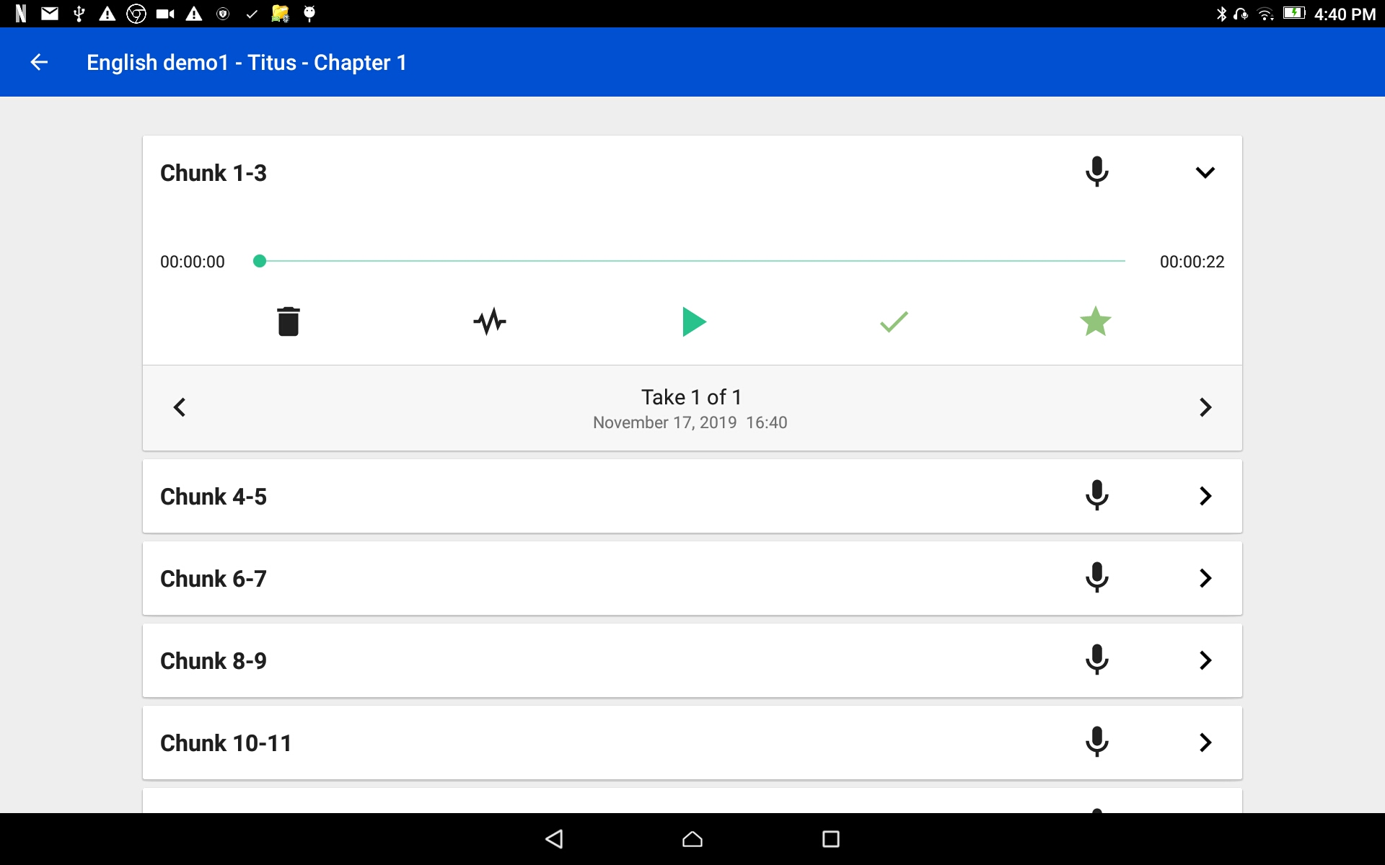
Rating a Recording
The Take Bar in Project Management shows the color rating.

